Slide 1

Apache Maven
Build Automation Tool
Notes:
https://medium.com/@smagid_allThings/uml-class-diagrams-tutorial-step-by-step-520fd83b300b

Slide 2
Key Features
simple project setup
project templates (named archetypes)
dependency management
central repository system
https://mvnrepository.com/

Slide 3
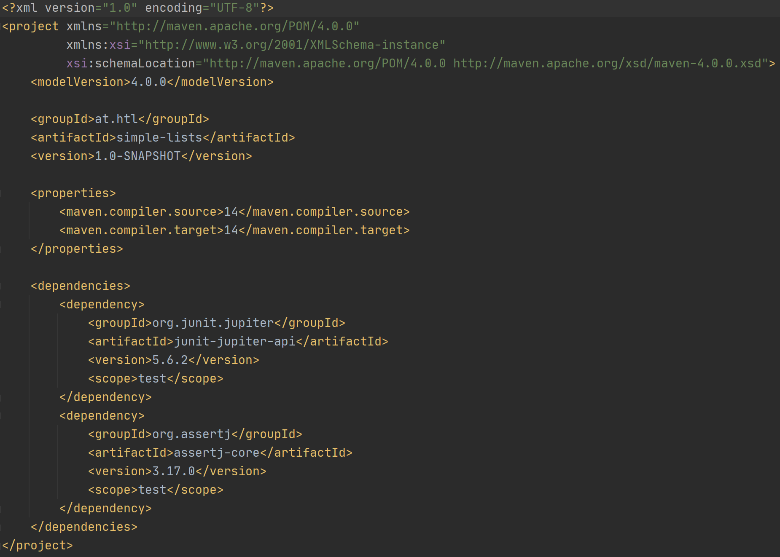
Project Object Model (POM)

Slide 4
Project Identifiers
<groupId>
unique name of project creator
follows Java’s package name rules
e.g. at.htl_leonding
<artifactId>
unique name of project
e.g. hello-world
<version>

Slide 5
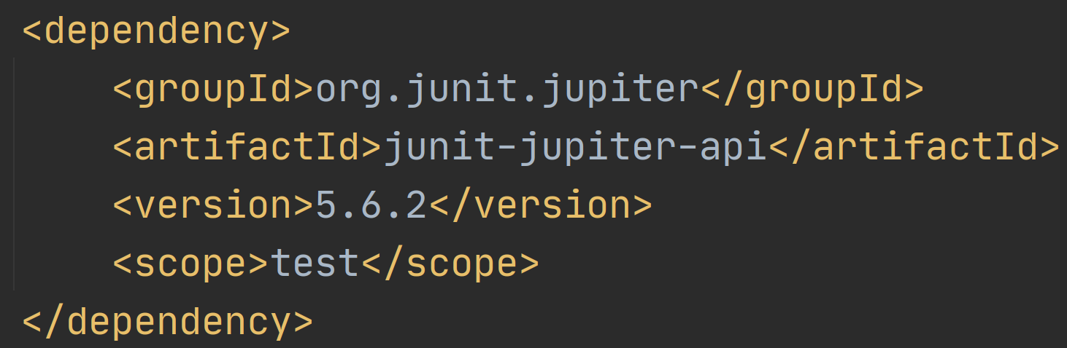
Dependencies
external libraries that a project uses
Maven ensures automatic download from a central repository
Notes:
https://maven.apache.org/guides/introduction/introduction-to-dependency-mechanism.html#Dependency_Scope

Slide 6
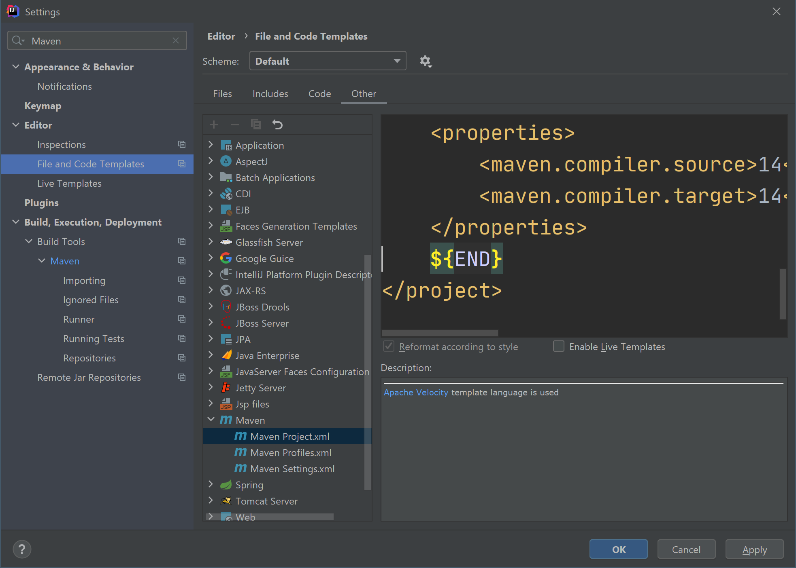
IntelliJ: How to edit pom.xml template

Slide 7
Resources
https://www.baeldung.com/maven
https://maven.apache.org/
http://maven.apache.org/guides/mini/guide-naming-conventions.html

